Slide 1


Slide 2
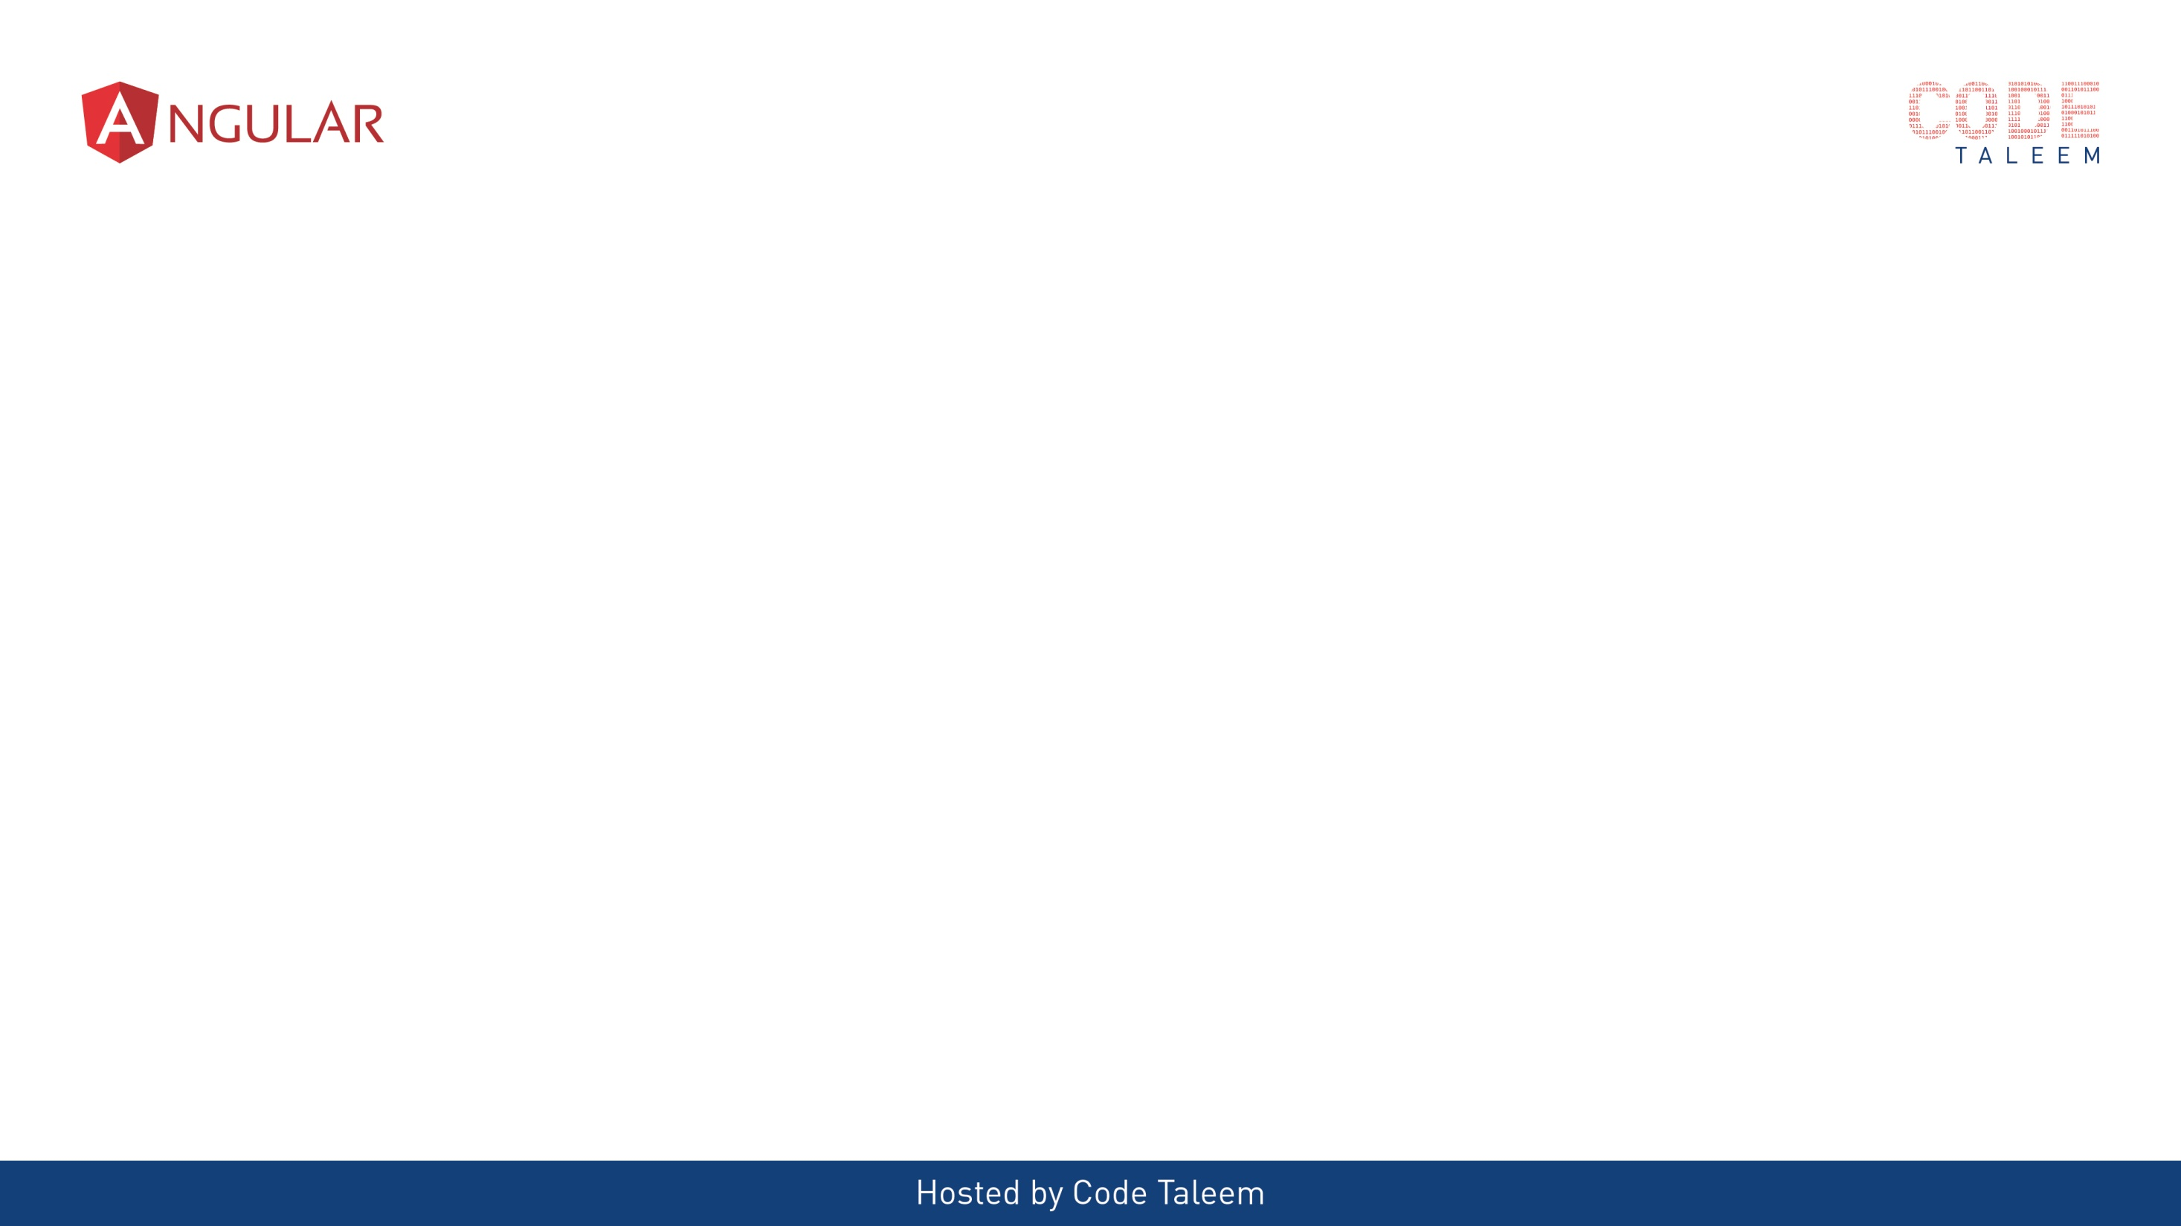
Chapter 1 - Angular Framework
Video contains:-
What is Angular & Why?
Difference between traditional website and SPA
Angular Js vs Angular (9)

Slide 3
What is Angular & Why?
Angular is a JS framework which allow you to create reactive Single Page Application.
Angular is building Mobile and desktop web applications
It written typescript-based open source web application framework led by Angular team at Google.
Better performance

Slide 4
Traditional Application
Single Page Application
Request for Pages
SERVER
Response for Pages
CLIENT
Request for Data
Response for Data
CLIENT
SERVER
Multiple Page requests going to Server.
Every response page getting reloaded
Single request to load the APP. Complete App package in first time response .
Multiple data requests going to Server.
Every response page not reloaded. Content only changed

Slide 5
AngularJs vs Angular (9)
Angular Js - The architecture of AngularJS is based on the model-view-controller (MVC) design. It is first version of Angular – oct-2010
Latest version – Angular 9 . Every six months release the new version.
Angular JS | Angular
MVC Design | Components and Modules
It is written in Javascript | It is written in Typescript
Not build in Mobile support | Mobile Support
$routeprovider.when() to configure routing | uses @RouteConfig{(…)}
Performance AngularJS was originally developed for designers, not developers | Better performance
Angular Js (V1)
Angular (V2)
Angular (V4)
Angular (V9)

Slide 6
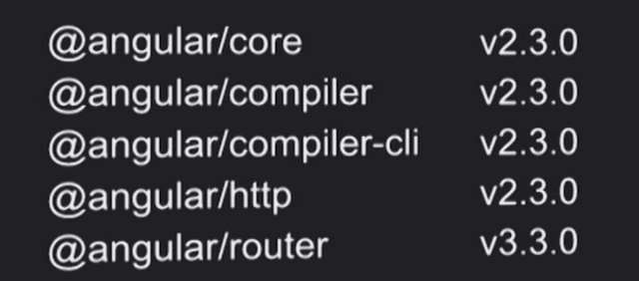
Why skip angular 3 ?
Angular is being developed in a MonoRepo.
@angular/core, @angular/compiler, @angular/router etc are in the same repo and may have their own versions.

Slide 7

Upcoming Video Chapter 2 - Angular 9 Features and Update
Video contains:-
Semantic Versioning
Angular 9 Features
Angular 9 Advantages
How to update current version

Slide 8
Chapter 2 - Angular 9 Features and Update
Video contains:-
Semantic Versioning
Angular 9 Features
Angular 9 Advantages
How to update current version

Slide 9
Semantic Versioning
Major (2.1.0): New Features, Potential breaking changes
Minor (2.1.0): New Features, No breaking changes
Patch (2.1.0): No Features, No breaking changes, Bug fixes
2
1
0
Major
Minor
Patch

Slide 10
Angular 9 Features
Welcome Default Ivy - the Ivy renderer is the default Angular compiler
- "angularCompilerOptions": { "enableIvy": true }
Angular Core Type-Safe Changes - One of the APIs for testing Angular apps is called TestBed
- TestBed.inject(ChangeDetectorRef) // ChangeDetectorRef
ModuleWithProviders Support
- All of your code becomes in sync with the latest changes
- ng update
Changes with Angular Forms
- <ng-form></ng-form>

Slide 11
Angular 9 Features
Dependency Injection Changes in Core
- @Injectable({ providedIn: 'platform' }) class MyService {...}
6. Enhancement of Language Service
7. Service Worker Updates
8. i18n Improvements
9. API Extractor Updates
Angular Component Updates

Slide 12
Angular 9 Advantages
Smaller bundle sizes
Faster testing
Better debugging
Improved CSS class and style binding
Improved type checking
Improved build errors
Improved build times, enabling AOT on by default
Improved Internationalization
New options for 'providedIn‘
IDE & language service improvements

Slide 13
Ivy size Improvements – Total bundle size chart

Slide 14
Updating to Angular Version 9
Updating CLI Apps
For step-by-step instructions on how to update to the latest Angular release, use the interactive update guide at update.angular.io
If your application uses the CLI, you can update to version 9 automatically with the help of the ng update script:
- ng update @angular/core@8 @angular/cli@8
- git add .
- git commit --all -m "build: update Angular packages to latest 8.x version"
- ng update @angular/cli @angular/core --next`

Slide 15
Upcoming Video Chapter 3 – Angular CLI & Project Skeleton
Video Contains:-
Prerequisites
CLI Commands
Project Skeleton Overview

Slide 16
Chapter 3 – Angular CLI & Project Skeleton
Video Contains:-
Prerequisites
CLI Commands
Project Skeleton Overview

Slide 17
Prerequisites
- HTML,
- CSS,
- Javascript,
- Typescript
- Node js ( based on Angular version 9 – node version 10 and above)
- npm install –g @angular/cli
IDE:
- Visual studio Code
Version check:
- node –v, npm –v, ng version

Slide 18
CLI Commands
https://angular.io/cli
ng help
ng generate --help
ng new my-first-project
ng serve
ng build my-app -c production
ng g m moduleName –flat –module=app
ng g m moduleName –routing
ng g c componentName --skipTests=true --inlineStyle=true

Slide 19
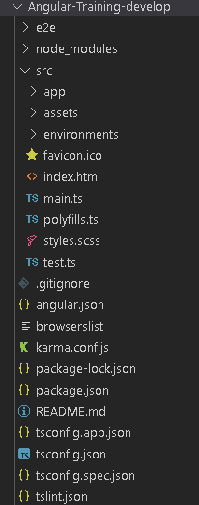
Project Skeleton Overview

Slide 20
Upcoming Video Chapter 4 – Angular Building blocks
Video Contains:-
Building block of Angular
Templates and views

Slide 21
Chapter 4 – Angular Building blocks
Video Contains:-
Building block of Angular
Templates and views

Slide 22
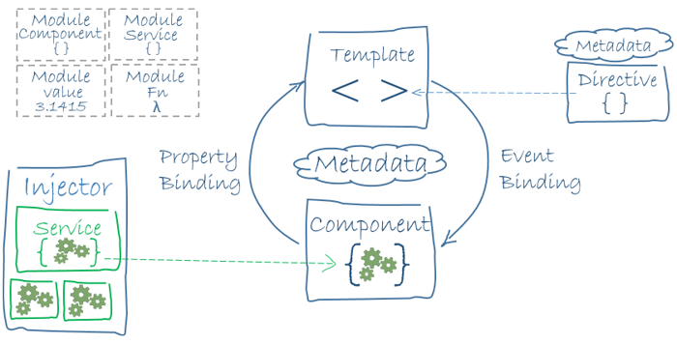
Building block of Angular
Modules
Components
Templates,
Metadata
directives, & data binding
Services & dependency injection
Routing

Slide 23
Modules
[Collection of Components]
Components
[App Data & methods]
Data Binding
[intermediates of component & Templates]
Templates
[Design Logic]
Dependency Injection
[Provide object to components]
Services
[Business Logic + API Calls]
Directives
[DOM Manipulation]
Routing
[Navigating URL]

Slide 24
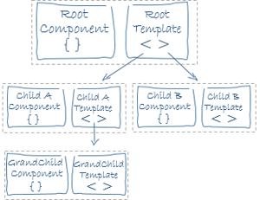
Templates and Views
templateUrl
template
styles
styleUrls

Slide 25
Upcoming Video Chapter 5 - Modules
Video Contains:-
Introduction of Modules
Generate Module using cli cmd
How to use in Code

Slide 26
Chapter 5 - Modules
Video Contains:-
Introduction of Modules
Generate Module using cli cmd
How to use in Code

Slide 27
Modules - Definition
In Angular, a module is a mechanism to group of components, directives, pipes and services
Declarations
Exports
Imports
Providers
Bootstrap

Slide 28
Modules – Cli cmd
ng g m modulename
Ng g m modulename --routing=true
Ng g m modulename --flat=true --module=module

Slide 29
Upcoming Video Chapter 6 - Components
Video Contains:-
Introduction of Components
Generate Component using cli cmd
How to use in Code

Slide 30
Chapter 6 - Components
Video Contains:-
Introduction of Components
Generate Components using cli cmd
How to use in Code

Slide 31
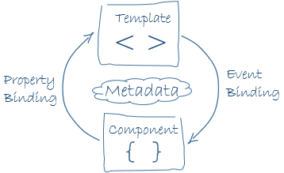
Components – Definition
Components are the most basic UI building block of an Angular app
A component consists of three primary elements:
The HTML template.
The logic
The styling

Slide 32
Components – Cli cmd
ng g c componentName
ng g c componentName --skipTests=true
ng g c componentName --inlineStyle=true --inlineTemplate=true

Slide 33


Slide 34
What is Databinding???
Data binding is the core concept of Angular 9 and used to define the communication between a component and the DOM

Slide 35
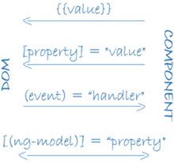
Types of Data Binding
String interpolation – {{}}
<li>Name: {{ user.name }}</li>
Property Binding – []
<input type="email" [value]="user.email">
Event Binding – ()
<button (click)=“checkMail()"></button>
Two-way Data Binding – [()]
[(ngModel)] = "[property of your component]"

Slide 36
Data Binding
Property Binding – [property-name]
<input type="email" [value]="user.email">
Attribute Binding – [attr.attribute-name]
<tr><td [attr.colspan]="3">three</td></tr>
Class Binding – [class.class-name]
<h1 [class.myClass]="isTrue">This class is true value</h1>
Style Binding – [style.style-name]
<h1 [style.color]="blue">This is a Blue Heading</h1>

Slide 37
Types of Data Binding
Two way data binding:
Typescript Code
(Business Logic)
Output Data
HTML Template
User Reaction

Slide 38
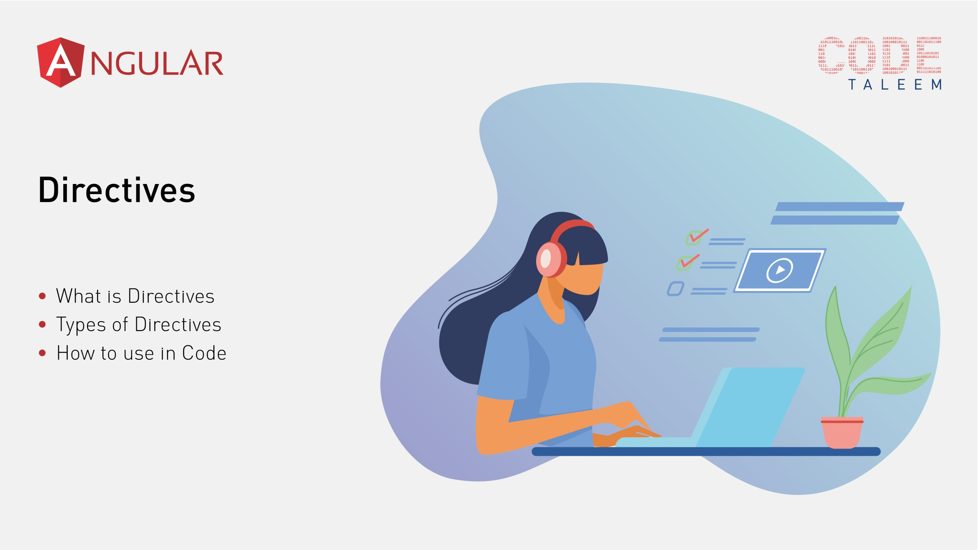
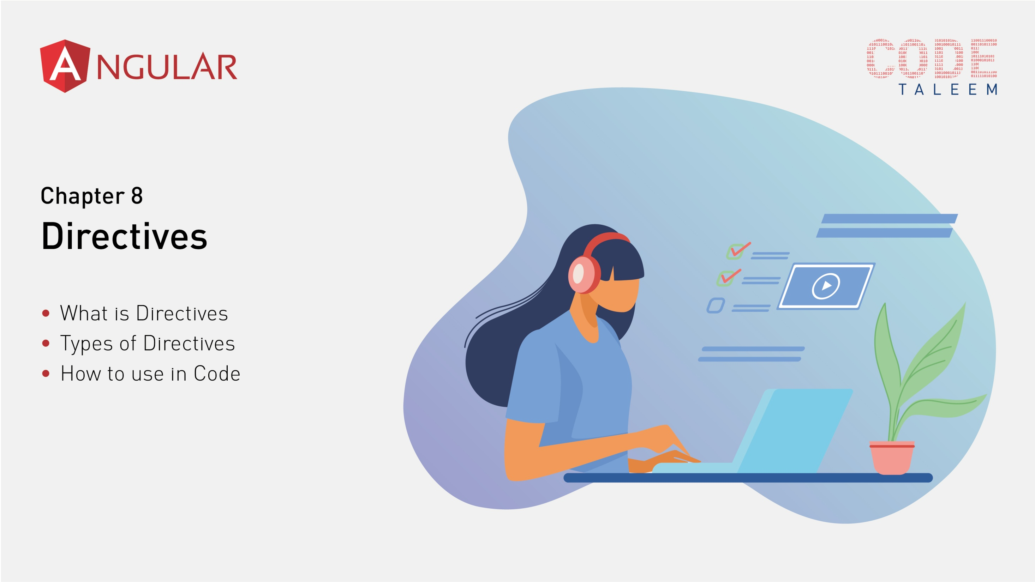

Slide 39

What is Directives ???
used to manipulate the DOM.
you can change the appearance, behavior or a layout of a DOM element. It also helps you to extend HTML.
Code Modular & Manageable – we can write code from separate the view. App logic seprately
Reusable code

Slide 40
Types of Directives
Component Directives
@Component directives are used in main class. They contain the detail of how the component should be processed, instantiated and utilized at runtime.
Structural Directives
*ngIf Directive, *ngSwitch Directive, *ngFor Directive
Attribute Directives
ngClass Directive, ngStyle Directive
Custom Directives
- CustomHighLighterDirective

Slide 41
Angular Directive
Component Directives
(Directives with a template)
Structure Directives
(change the layout of the element)
Custom Directives
(You can create your own directives)
Attribute Directives
(Change appearance or behavior of the particular element)

Slide 42

Chapter 9
Directives
Structural Directives
Attribute Directives
Custom Directives

Slide 43
Types of Directives
Component Directives
@Component directives are used in main class. They contain the detail of how the component should be processed, instantiated and utilized at runtime.
Structural Directives
*ngIf Directive, *ngSwitch Directive, *ngFor Directive
Attribute Directives
ngClass Directive, ngStyle Directive
Custom Directives
- CustomHighLighterDirective

Slide 44
How to use in code?
Attribute Directives
ngClass Directive
ngStyle Directive
Custom Directives
- CustomHighLighterDirective
- ng g d directiveName options

Slide 45
Chapter 10
Lifecycle Hooks - Overview
ngOnChanges
ngOnInit
ngDoCheck
ngAfterContentInit
ngAfterContentChecked
ngAfterViewInit
ngAfterViewChecked
ngOnDestroy

Slide 46
Lifecycle Hooks
Constructor ( not lifecycle hook)
- Constructor always called first
ngOnchanges
- Its called when any input data bound property change
ngOnInit
- Its called when component is initialized
ngDoCheck
- Its called when any change detection

Slide 47
Lifecycle Hooks
ngAfterContentInit
- Its called after content projected in to the component view
ngOnContentChecked
- Its called after angular checks ng-content projected into the component view
ngAfterViewInit
- Its called after the component view – child view initialized
ngAfterViewChecked
- Its called after the component view – child view checked

Slide 48
Lifecycle Hooks
ngOnDestroy
- Its called when the component will destroyed.
- Clean up just before Angular destroys the directives or components.
- *ngIf element removed.
Note:
initialise your components is in the ngOnInit not in constructor
mostly don’t use ngOnChanges and ngDoCheck in same component
ngOnChanges not detect object passed by reference

Slide 49
Lifecycle Hooks – With live example
Import the class in top
Implement the interface
Create lifecycle hook function
Constructor
OnInit
OnChanges

Slide 50
Chapter 11
Lifecycle Hooks – example
ngOnChanges
ngOnInit
ngDoCheck
ngAfterContentInit
ngAfterContentChecked
ngAfterViewInit
ngAfterViewChecked
ngOnDestroy

Slide 51
Lifecycle Hooks – With example
DoCheck
Difference between OnChanges and DoCheck
AfterContentInit
AfterContentChecked
(note: Import the class name in top, Implements the interface, Inside of component should be declare the property name)

Slide 52
Difference between Onchanges and DoCheck
ngOnChanges called when input property changed but ngDoCheck called all the time when view detect any changes
ngOnChanges not detect passed by Reference but ngDoCheck detect
(note: Import the class name in top, Implements the interface, Inside of component should be declare the property name)

Slide 53
Chapter 12
Lifecycle Hooks – example
ngOnChanges
ngOnInit
ngDoCheck
ngAfterContentInit
ngAfterContentChecked
ngAfterViewInit
ngAfterViewChecked
ngOnDestroy

Slide 54
Lifecycle Hooks
The best place to initialise your components is in the ngOnInit lifecycle hook and not the constructor because only at this point have any input property bindings been processed. The reason we use ngOnInit and not ngOnChanges to initialise a component is that ngOnInit is only called once whereas ngOnChanges is called for every change to the input properties.
ngDoCheck – check object by reference value itself. But ngOnChanges not checked object by reference value
Product = { name :’shil value’ }
this.product.name = ‘shil value’ – not detect ngOnChanges

